Slide 1
Power BI Services
First contact
Power BI Services
First contact

Slide 2
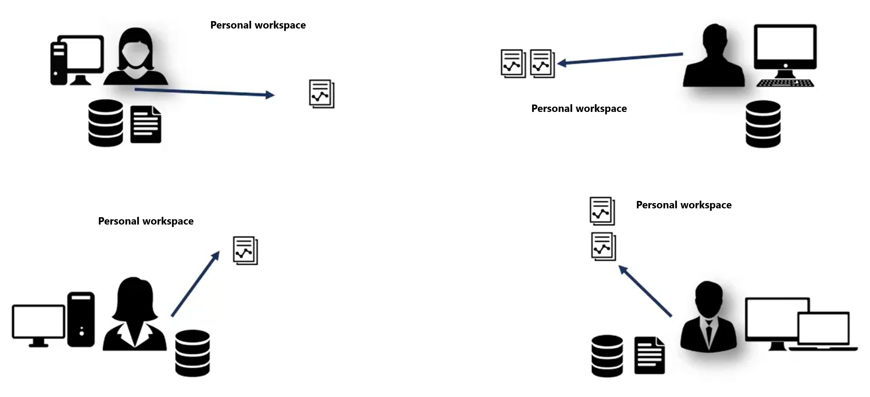

Understand the need of Power BI Services

Slide 3

Understand the need of Power BI Services

Slide 4

Understand the need of Power BI Services

Slide 5
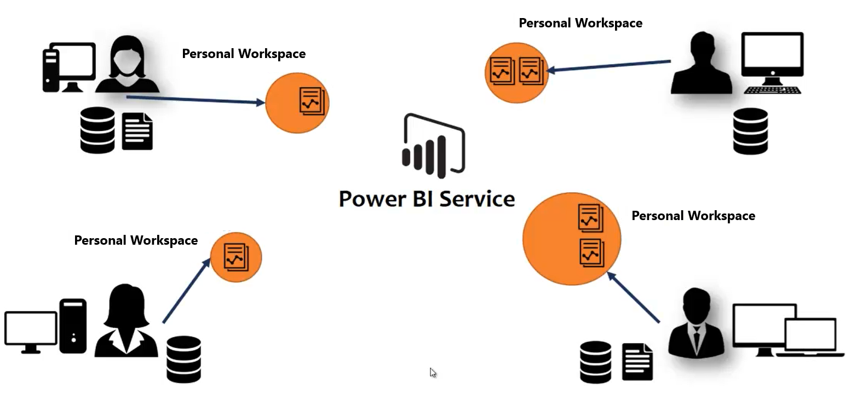
Understand the need of Power BI Services

Slide 6

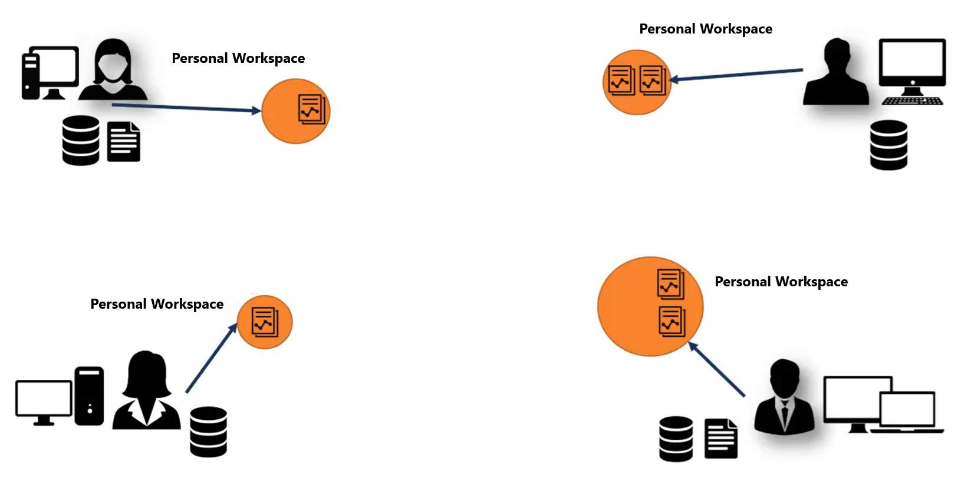
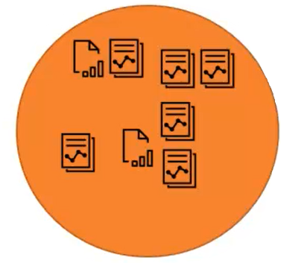

Understand the need of Power BI Services
Shared Workspace

Slide 7
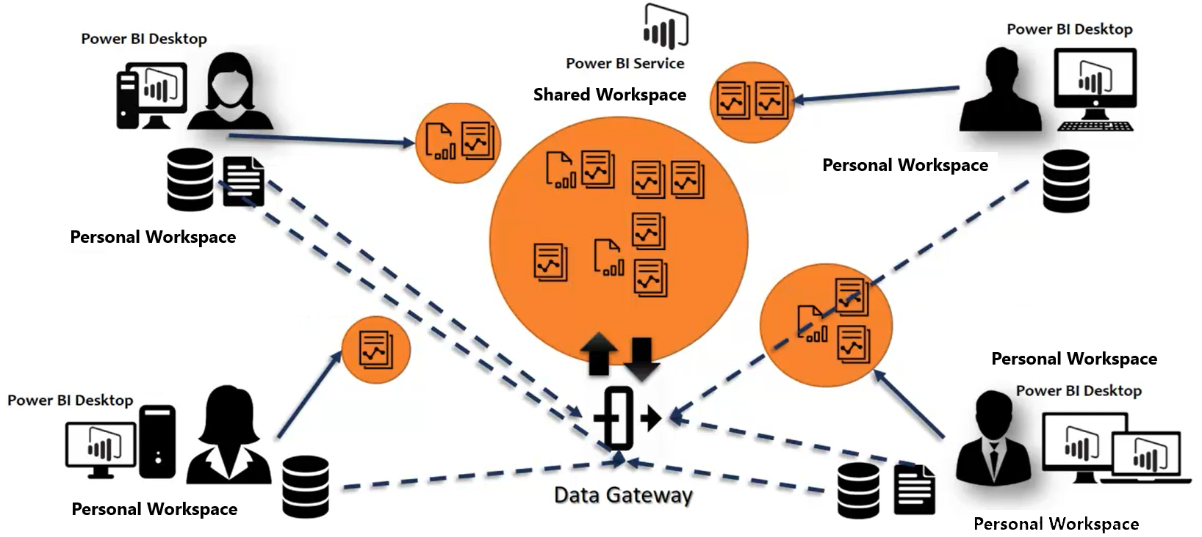
Understand the need of Power BI Services

Slide 8
Thank you
Thank you

